Slide 1
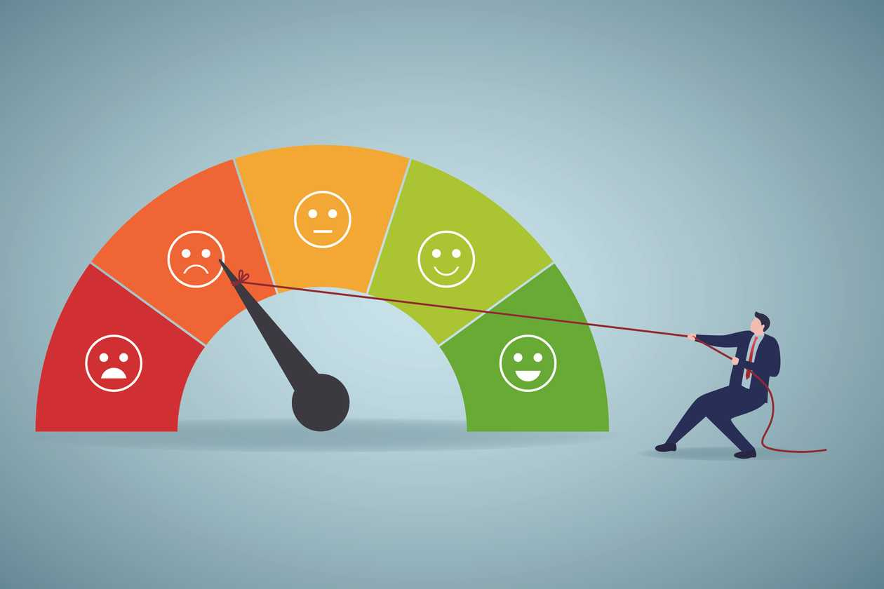
Credit score EDA and Prediction
By: omar kamel
AI Engineering undergraduate student
Supervisor:Dr.Doaa Mahmoud

Slide 2
Agenda:
Definition and Task Statement
Data Report
Objective Data problems and Cleaning
Exploratory Data Analysis
Modelling and Accuracy

Slide 3
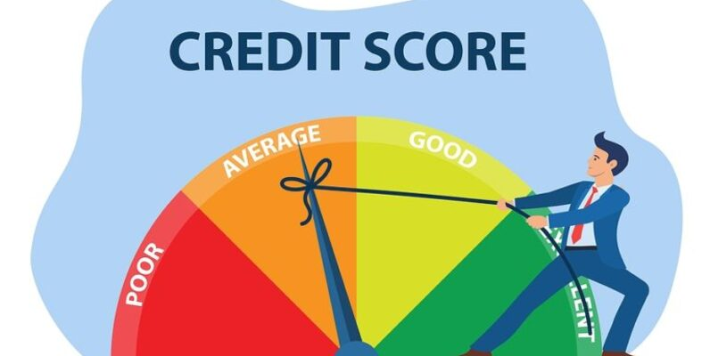
What is the Credit score?
A credit score is a prediction of your credit behavior, such as how likely you are to pay a loan back on time, based on information from your credit reports.

Slide 4

What is Credit score?
Generally speaking, scores between 690 to 719 are considered good in the commonly used 300-850 credit score range.
Scores 720 and above are considered excellent, while scores 630 to 689 are considered fair. Scores below 630 fall into the bad credit range.
Task Statement:
perform analysis, identify factors influencing credit

Slide 5
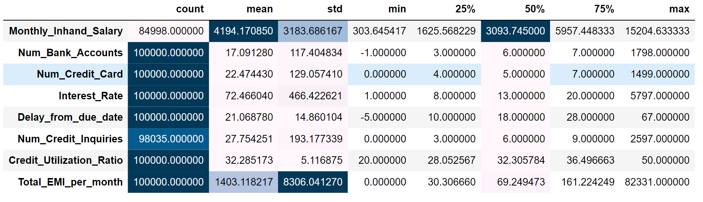
Data statistics

Slide 6
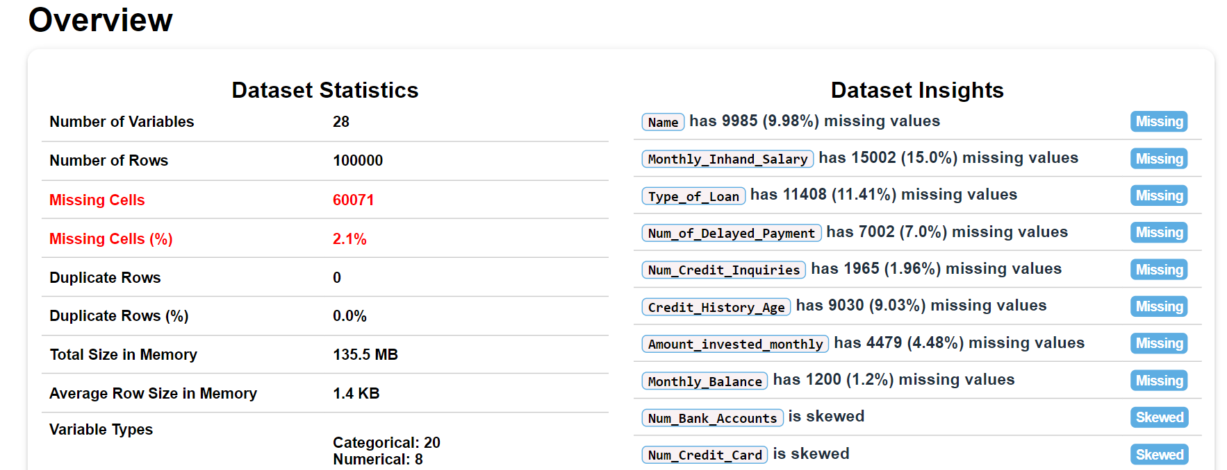
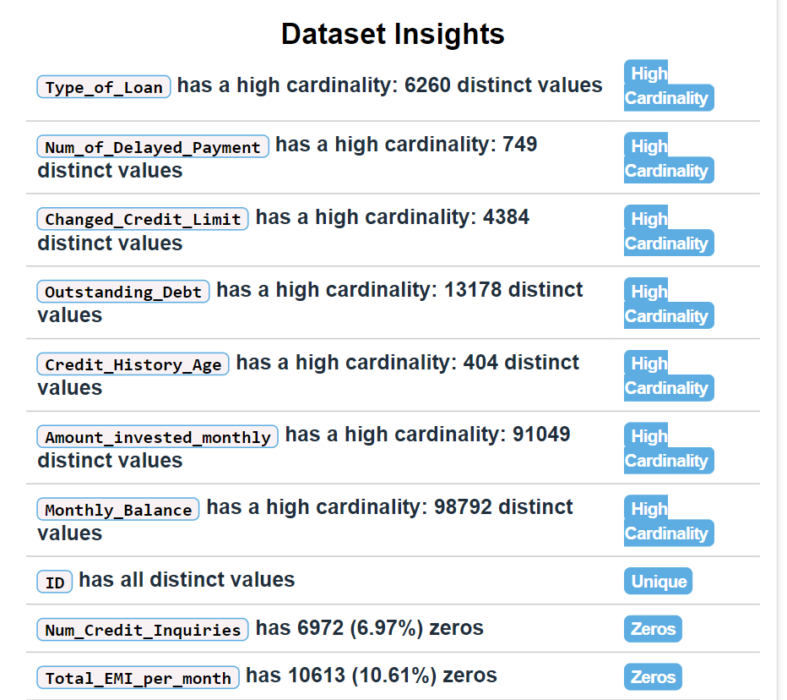
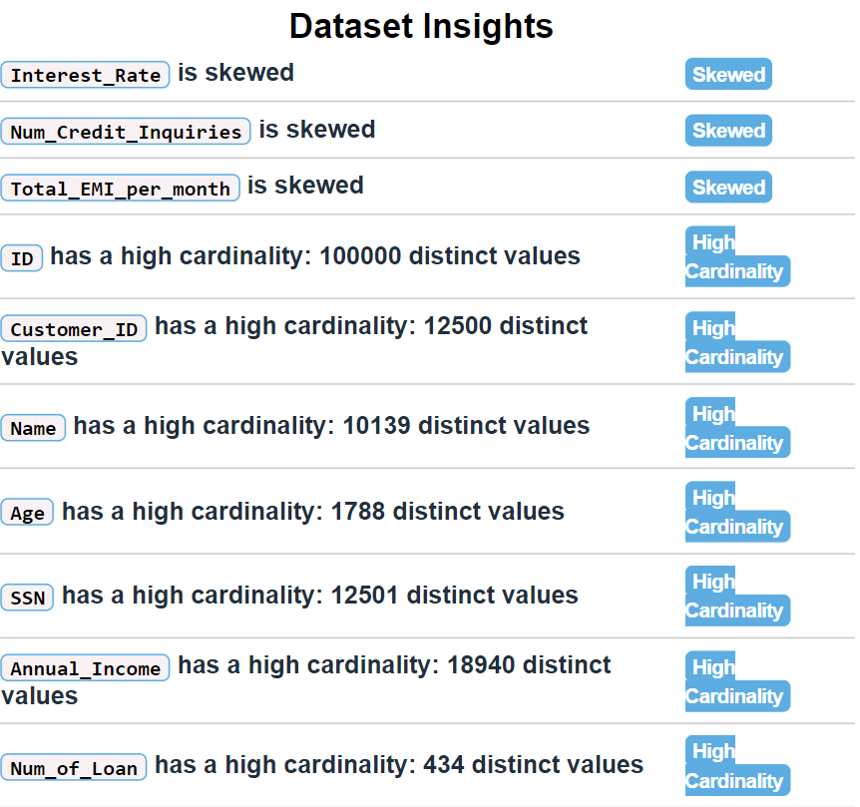
Report

Slide 7
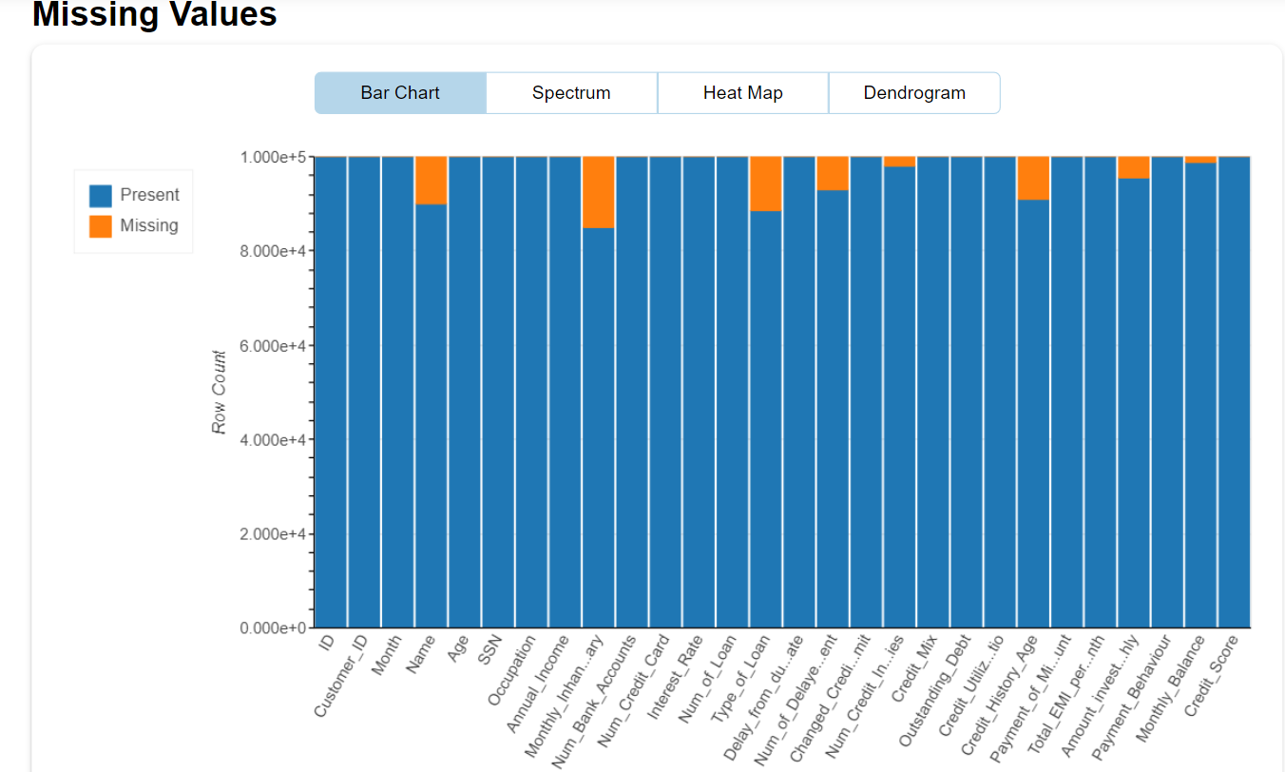
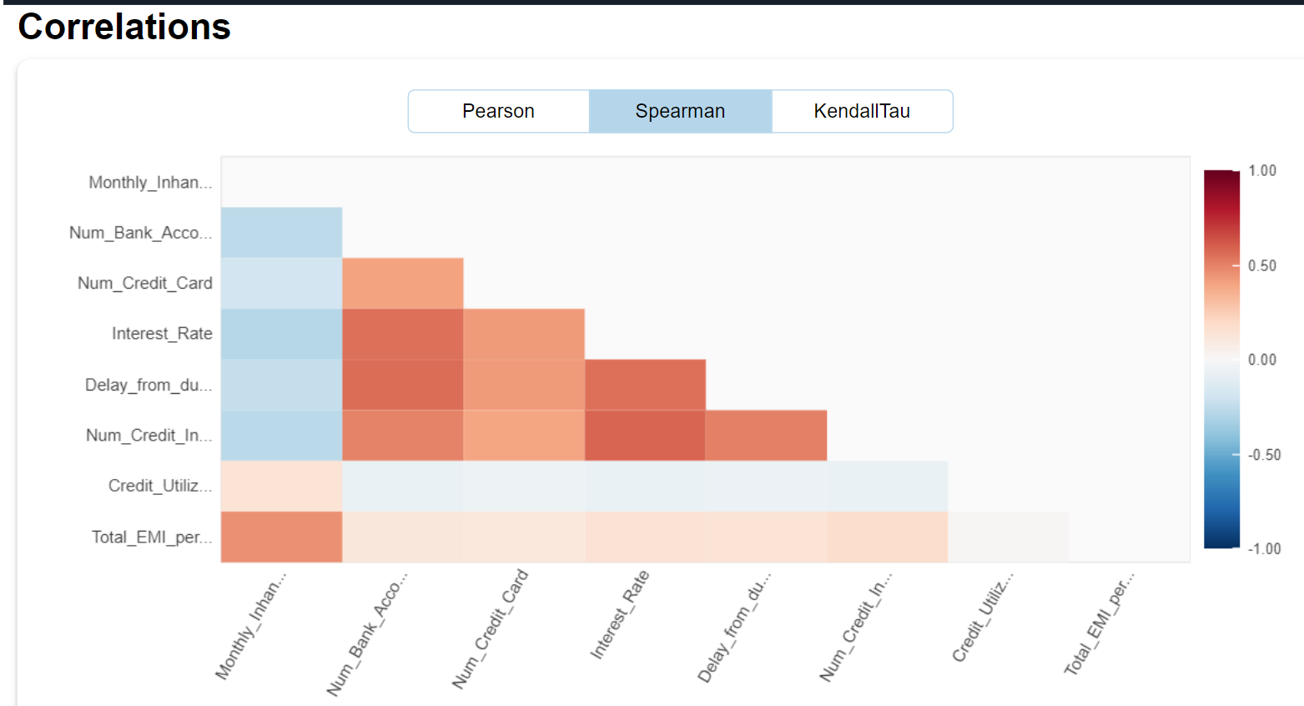
Report
There is a huge missing value

Slide 8
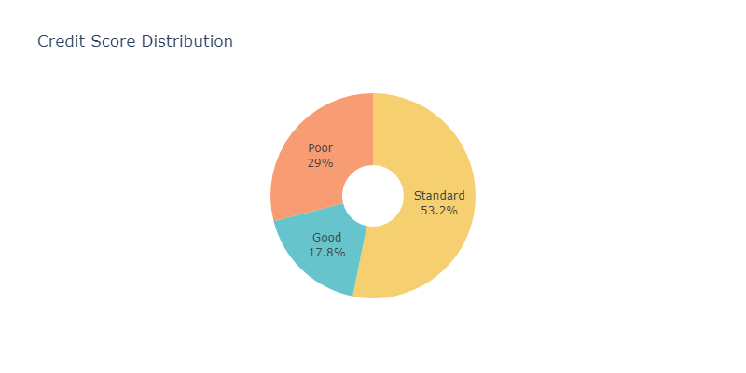
53.2% of the data is standard and17.8%is good Problem Statement: the category of good credit is 17% that so bad and more 50% of credit is standard

Slide 9
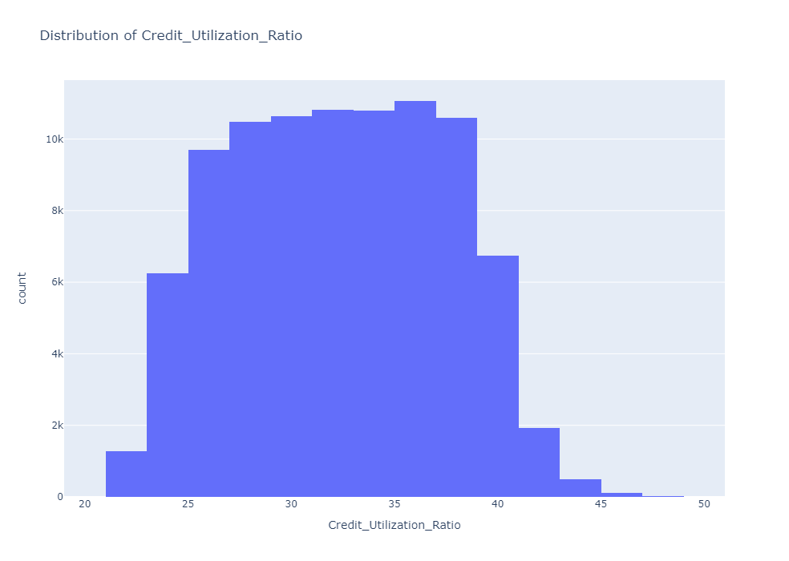
1:Credit_Utilization_Ratio
Feature Exploration Feature Problem
Lenders usually like to see users' credit utilization ratios of 30% or less. Users with higher credit utilization ratios may be considered as a higher risk, resulting in higher interest rates or a lower probability of credit approval. Generally, it is a good idea for users to keep their credit utilization ratio as low as possible, especially below 30%, to maintain a good credit rating.
Credit utilization is a measure of how much of a borrower's available credit they are currently using. It is calculated by dividing the borrower's total outstanding balances by their total credit limit.

Slide 10
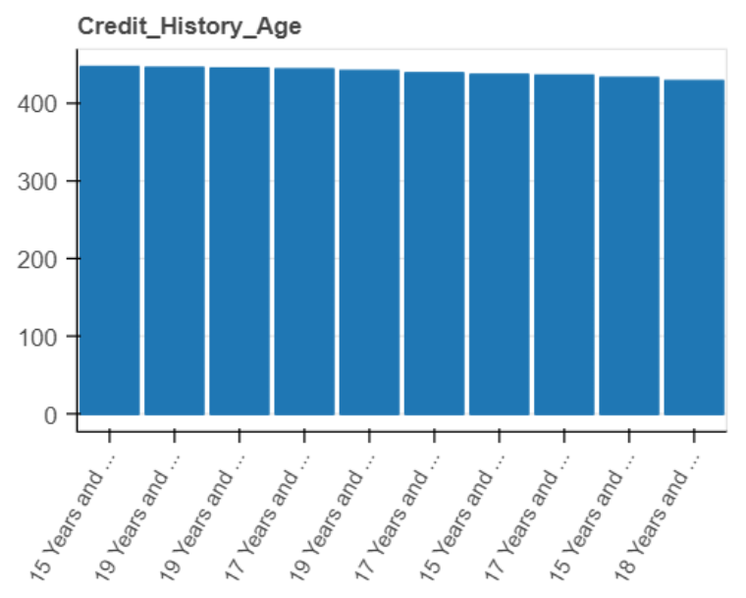
2:Credit_History_Age
Feature Exploration Feature Problem
There is a definite mistake in the age of the card, but they are close to each other, and the highest age of the card is approximately 32 years

Slide 11
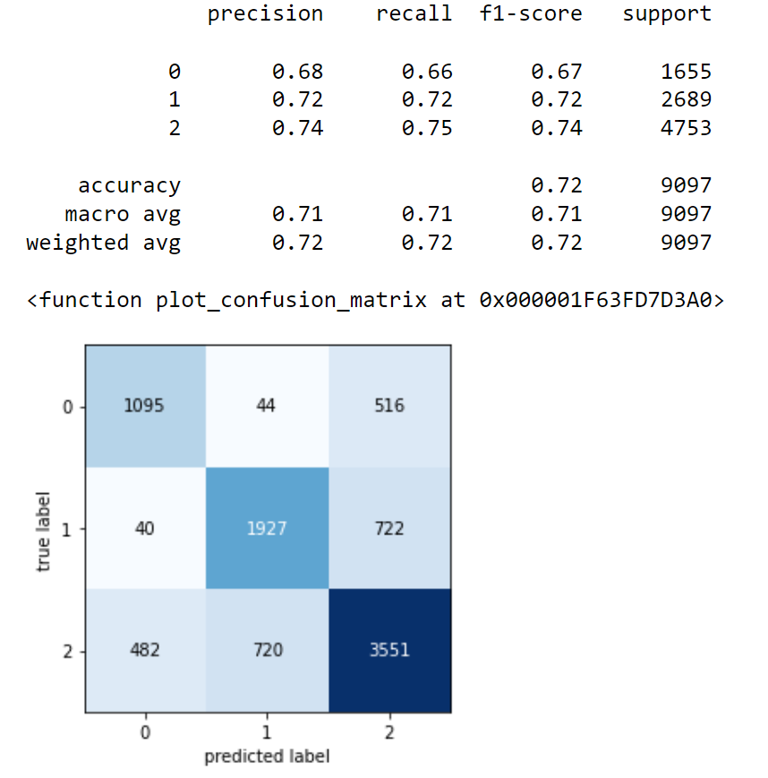
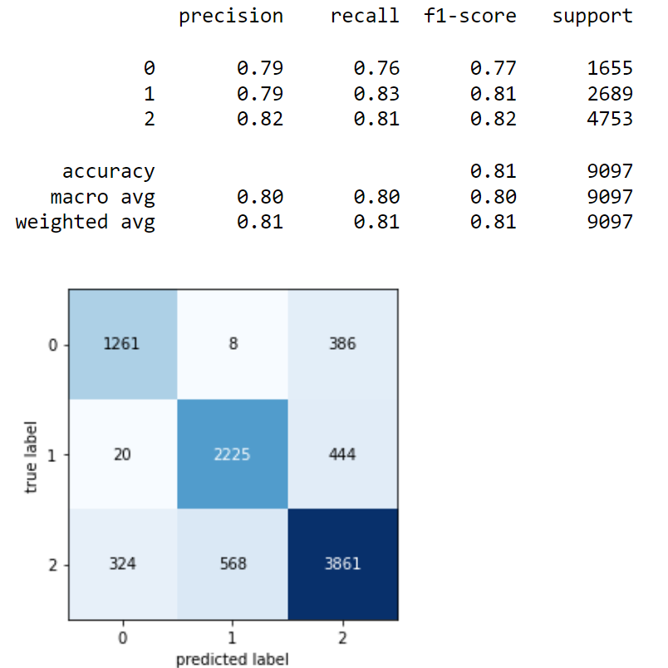
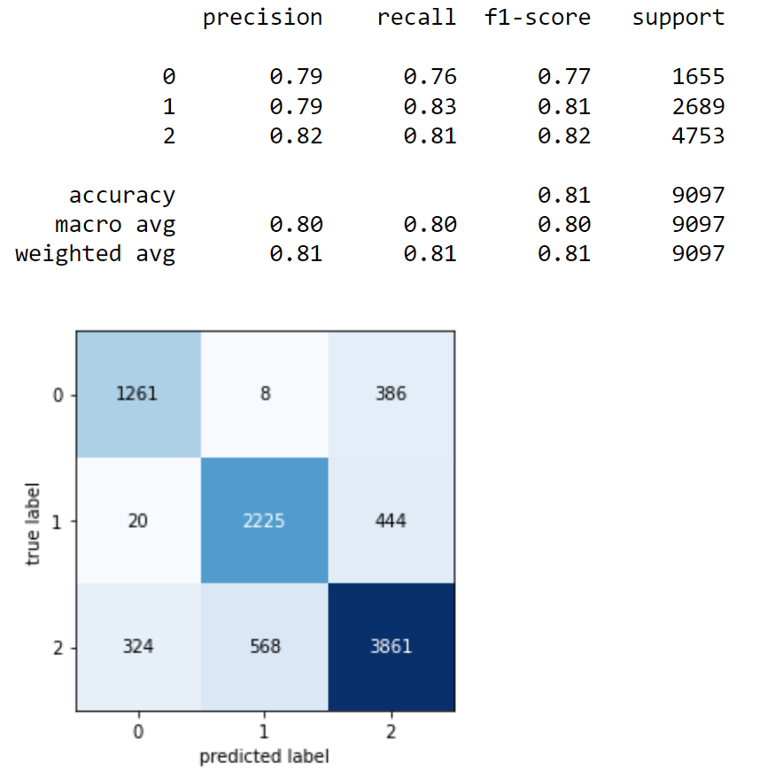
3:Modelling
2:RandomForest
1:DecisionTree
3:KNeighbors

Slide 12
Conclusion:
After we adjusted the missing values and made a graph showing what problems affect the credit score, we conclude that:
Credit utilization: Credit utilization, or the amount of debt used compared to the amount of credit available, also affects credit scores. Using a large amount of debt compared to available credit can lead to decreased credit scores.
Length of credit history: The length of credit history reflects the consumer's ability to manage debts over a long period of time. Generally, it is better for consumers to keep their credit accounts open for long periods of time without closing them abruptly, as closing credit accounts suddenly can lead to decreased credit scores.
Credit mix: Credit mix reflects the diversity of a consumer's credit accounts, such as student loans, car loans, and mortgages, and can lead to increased credit scores.
Credit inquiries: Credit inquiries refer to the number of times a consumer's credit history is checked and can lead to decreased credit scores if there are too many inquiries.

Slide 13

Special Thanks to Dr.Doaa Mahmoud for her support, amazing help The best of luck to her from the bottom of my heart.

